Slide 1










BETWEEN HIGH SCHOOL AND COLLEGE: THE UNSPOKEN WAY SIDE
Presentation by Jimilia Harris, Takiyah Green, Jordan Hunt, Lemuel Mutah, Lan Dinh

Slide 2
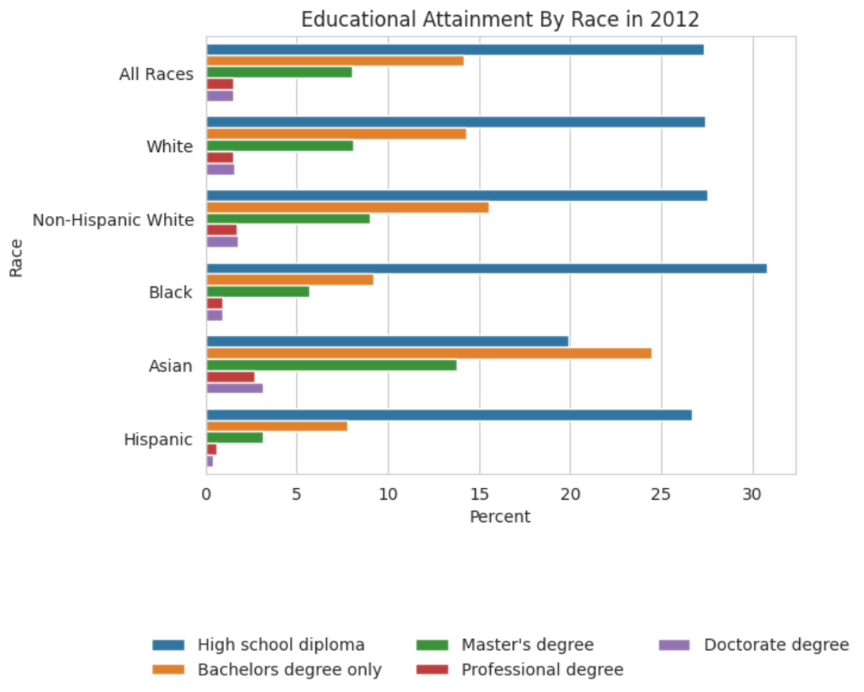
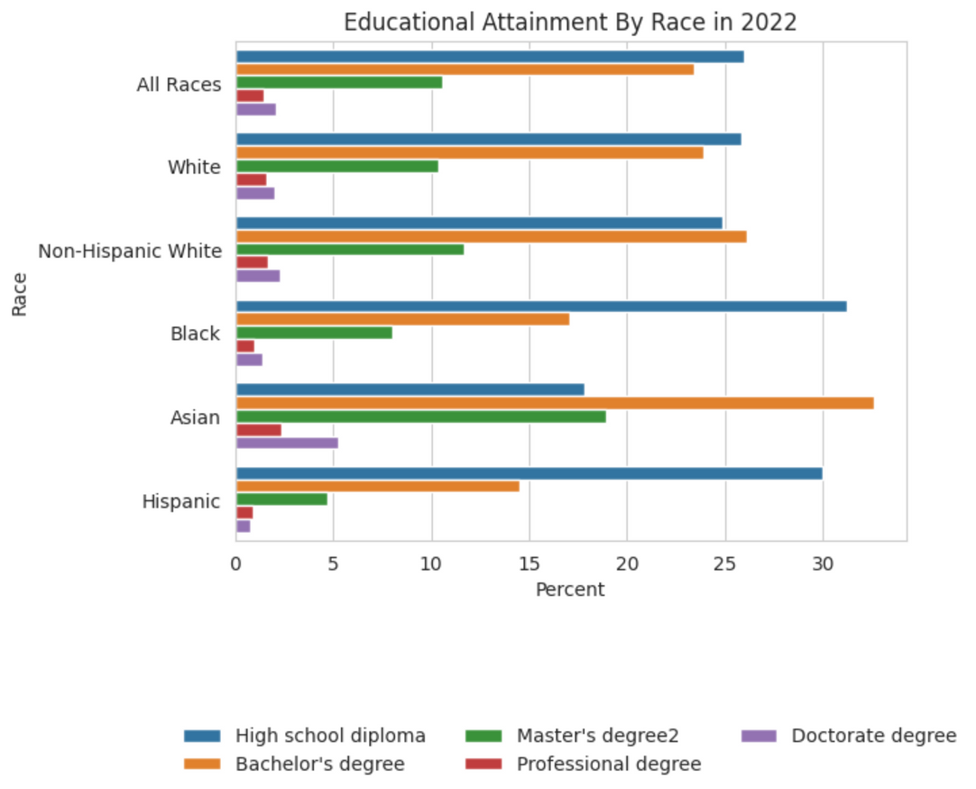
2012 & 2022 Educational Attainment Comparison:
Data source: United States Census Bureau

Slide 3
STRUCTURE
Background
Factors
Potential Conclusion &
Next Steps
  Comparing the 2012 and 2022 % educational attainment
  Research Question: What are some of the factors that drive the enrollment of African American students in college?
  Reviewing potential legal factors on education
  High schools effect on higher education enrollment
    AP Courses
    Faculty
    Resources
  Parent education level
    Support given during school
  Financial burden
    Financial literacy
  Potential Conclusion:
    This is a multifaceted issue that needs further research
  Next Steps:
    Surveying potential first generation college students
    Focusing on the lack of support

Slide 4
BACKGROUND: RESEARCH QUESTIONS
  What are some of the factors that drive the enrollment of African American students in college?
    Is the percentage of Black students graduating high school lower than white students?
      If so, is that the cause of the gap between Black and white student college enrollment and completion?
    Is financial cost of college the only deterrent of Black students from college?
      Are there internal household issues that exacerbate the financial deficit many students have for college?
    How do individual parents and schools affect their students and their enrollment in college?

Slide 5
Factors: Systemic Issues
Disparities in enrollment are not only a family, finance, and school issue…
It’s also a systemic issue:
  HR 471 (2011) - defunded DoE funds for education of disadvantaged groups
  DENIAL of S-117 (2015) Amendment 2139 - called for State funds that were used for disadvantaged students to continue being used by students once they went to an in-state institution
SOURCES:
  (https://www.govtrack.us/congress/bills/subjects/education/5991#text=college&congress=112&enacted_ex=on)
    HR 471 (2011)
  (https://www.govtrack.us/congress/bills/114/s1177/summary)
  S-117 (2015)

Slide 6
FACTORS: PARENTAL EDUCATION & FINANCE
Parental Education
  Educated parents enhance their children’s communication skills and broadens their vocabulary
  Parental education has been identified as the single strongest correlate of children’s success in school, the number of years they attend school, and their success later in life
Finance
  According to the National Postsecondary Student Aid Survey from 2019-2020:
    48% of Black students received a federal student loan, which is 13% more than the overall student percentage of 35%
  According to the National Center for Education Statistics
    2015 -16 Black students took out the highest number of loans and received the highest number of grants.

Slide 7
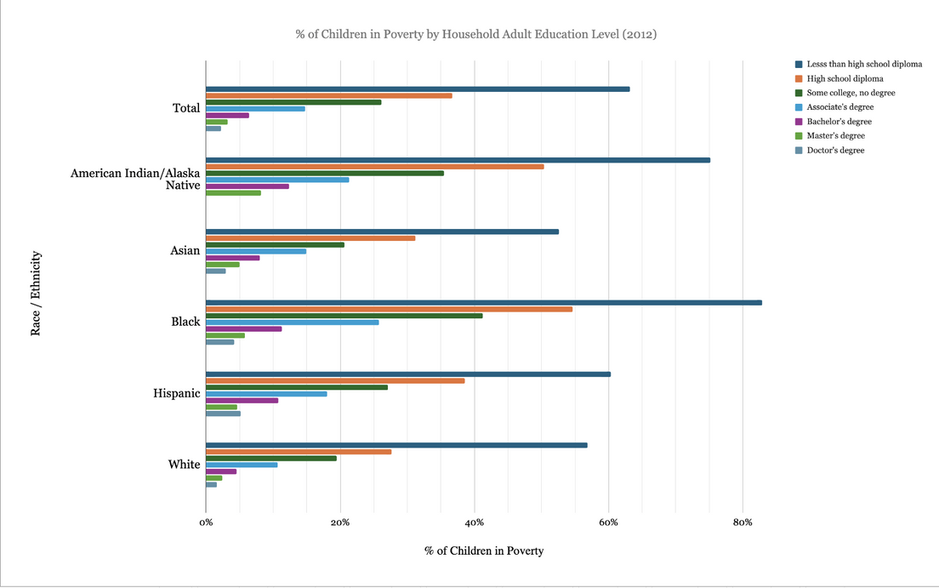
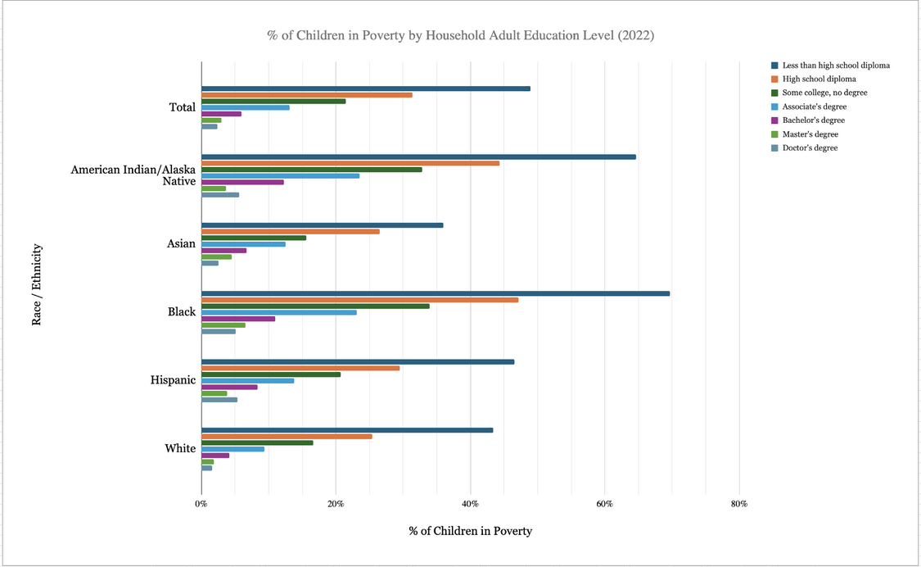
2012 & 2022 Poverty Percentage by Adult Education Level
Data Source: U.S. Department of Commerce, Census Bureau, American Community Survey (ACS), 1-Year Public Use Microdata Sample (PUMS) data, 2012 and 2022.

Slide 8
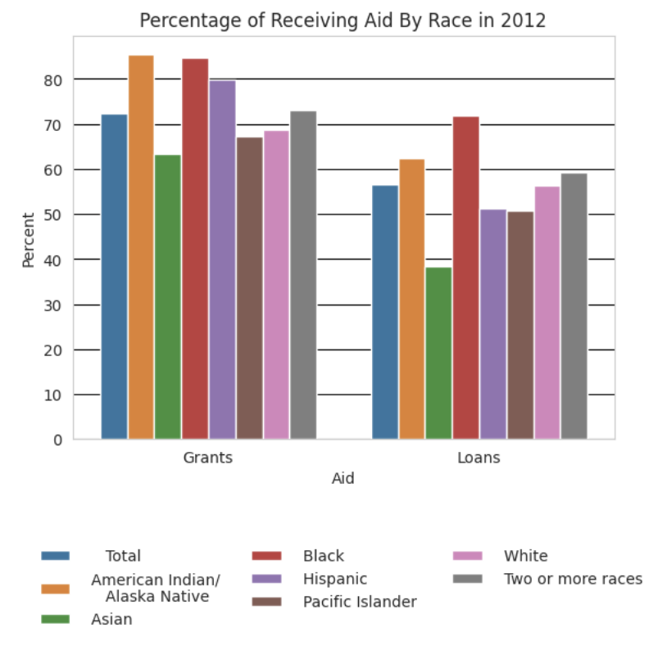
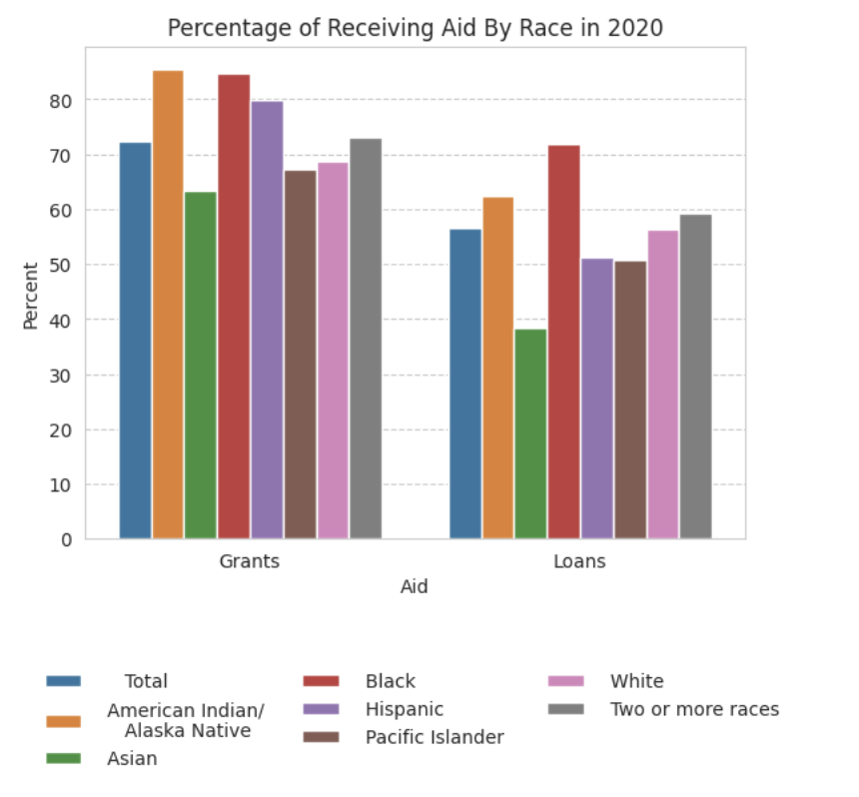
2012 & 2020 Percentage of Receiving Aid by Race
Data Source: U.S. Department of Education, National Center for Education Statistics, 1999-2000, 2003-04, 2007-08, 2011-12, and 2015-16 National Postsecondary Student Aid Study

Slide 9
FACTORS: HIGH SCHOOL PREP
  In 2011, research highlighted several characteristics of schools that promoted college education
    Rigorous coursework
    Teachers and staff share the mindset of all students can go to college and it is the faculties responsibility to make that happen
  However, disadvantaged schools are lacking these characteristics
  This begins by creating academic environments that focus on preparing all students for college, including engaging students in rigorous coursework and creating strong norms for performance. It also requires teachers and staff to develop shared goals that “all students can go to college and it is their personal responsibility to try and make that happen” - “Potholes on the Road…”

Slide 10
FACTORS: HIGH SCHOOL PREP
  “Diverse schools foster exploratory adolescence, orienting students towards open-ended and long-term educational goals. Disadvantaged schools promote expedited adulthood, an approach that prioritizes pragmatic over academic training in hopes of accelerating students’ paths to economic stability and self-sufficiency. ” - (Advising through Adversity: Urban High Schools’ Diverging Approaches to Postsecondary Planning)
  In 2024 research revealed that disadvantaged schools have several differences and promote:
    Expedited adulthood
      An expedited timeline for students to have economic stability and self-sufficiency
    Minimal emphasis on college application and attendance

Slide 11
High School Counselor’s Lack of Support
  Over the years the job description of high school counselor has changed. They went from their sole purpose being college advisors to adding on the responsibilities of being an administrator and mental health advisor.
  Studies show that students that who sought out college info enrolled into a 4 yr uni but studies don’t specify were this help was coming from.
  One thing researchers have noticed a correlation between is a rigorous hs curriculum leading students to a 4 yr uni.
  Students need social capital in in order to successfully matriculate from high school to college. School counselor’s can be essential to developing

Slide 12
NEXT STEPS
Target Demographic
Identified Problems
Question
Data Collection Methods:
  Potential first generation African-American students in US
  Lack of Support
    From parents
    From school
  Understand the perceptions of college
Are the existing resources in high schools effective in increasing African American students applying for colleges?
  Surveying Seniors in high school
  Interviewing college admission faculty
  Collecting quantitative data from existing resource organizations

Slide 13




Conclusion:
The gap between white student and black student college enrollment is one that is multifaceted. This gap is seemingly caused by systemic issues, parental education attainment, financial issues, and a lack of high school support and preparation.
Systemic Issues
Parental Educational & Finance
High School Prep
Factors affecting Black Student College Enrollment:

